Slide 1
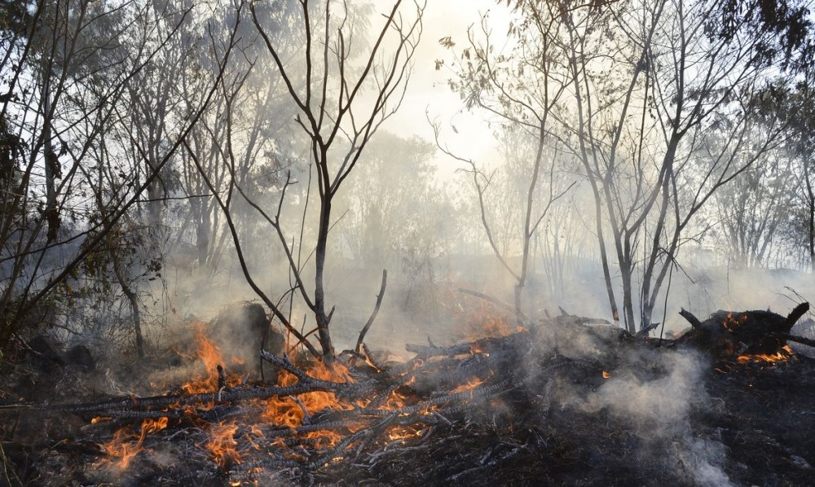
Modeling Of Fire Propagation With Cellular Automata

Slide 2
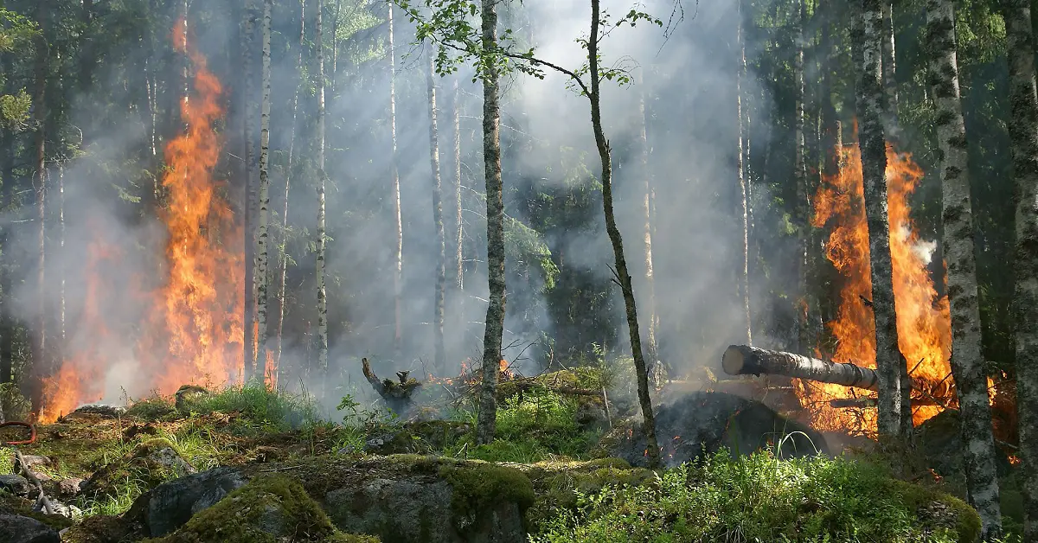
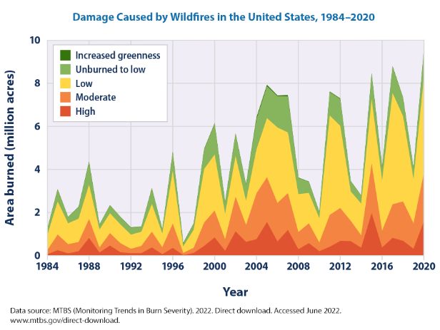
Introduction
Definition of Wildfires
Increasing prevalence and destructiveness
Need for advanced simulation models
Notes:
Wildfires, uncontrolled fires spreading across vegetation, have become increasingly prevalent and destructive, posing severe threats to ecosystems, communities, and infrastructure .The escalating frequency and intensity of wildfires in recent years necessitate advanced simulation models to better understand and predict fire behavior [3]. Traditional approaches to wildfire modeling often fall short in capturing the dynamic nature of these events, considering factors such as environmental zones and wind effects. Historically, wildfire modeling has predominantly focused on deterministic models that simplify the complex dynamics of fire spread . These models often neglect the influence of diverse environmental conditions, such as different types of vegetation, urban structures, and the transitional interfaces between them. As a result, their predictive accuracy is limited, hindering effective wildfire management and response planning.

Slide 3
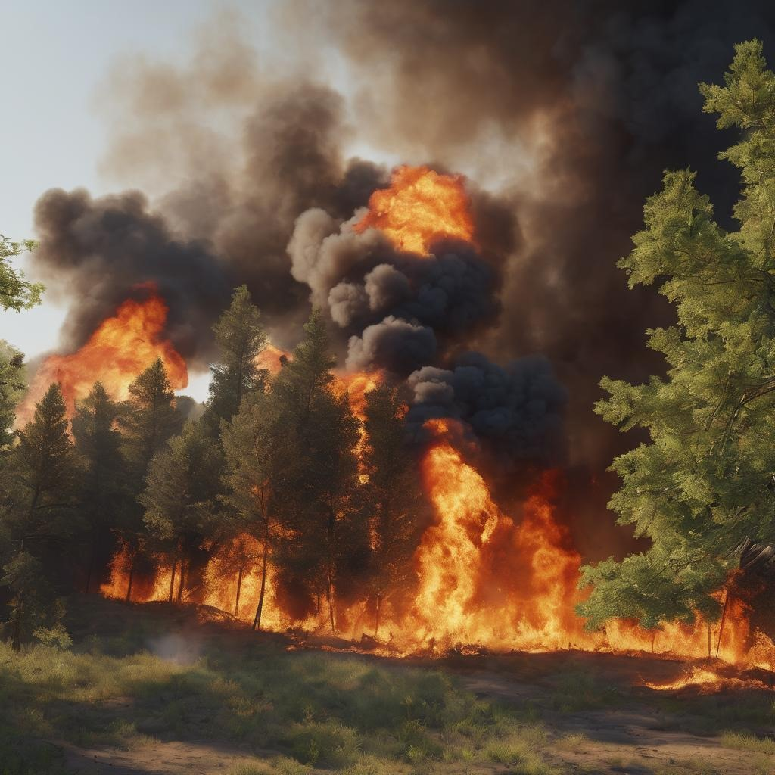
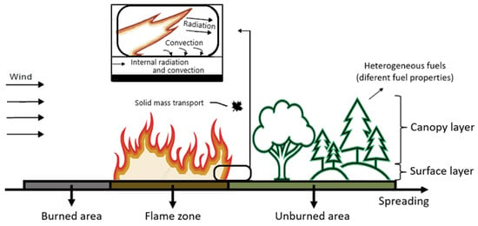
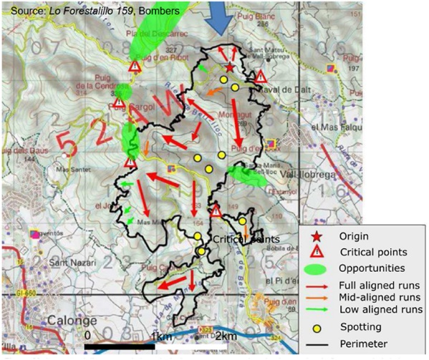
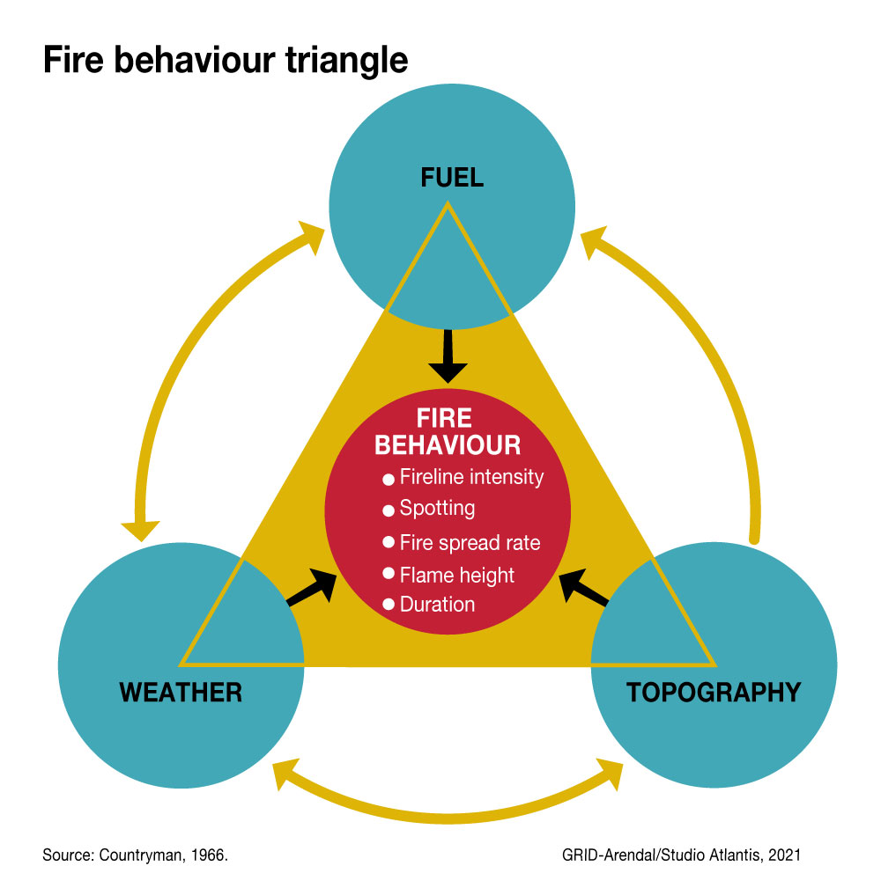
Challenges in Wildfire Modeling
Traditional deterministic models limitations
Influence of diverse environmental conditions
Importance of zone-specific parameters, wind effects, and stochastic modeling
Notes:
1. Traditional Deterministic Models:
Historically, wildfire models have often adopted deterministic approaches, simplifying fire spread dynamics. Notable models, such as Rothermel's surface fire spread model [14] and the Canadian Forest Fire Weather Index (FWI) System [15], consider factors like fuel type, slope, and weather conditions. However, these models tend to overlook zone-specific parameters and wind effects, limiting their ability to capture the complexities of diverse landscapes.
2. Zone-specific Modeling:
Recent studies acknowledge the importance of considering environmental zones in wildfire modeling. Sanderlin et al. [16] proposed a coupled atmosphere-fire model that simulates wildfire spread through interfaces, incorporating zone-specific characteristics. While Sanderlin's model introduces zones, it doesn't integrate wind effects comprehensively. Our approach extends this by explicitly defining and integrating zone-specific parameters, allowing a more nuanced representation of real-world fire behavior.
3. Wind-driven Wildfire Spread Models:
Research on wind-driven wildfire spread has been pivotal in understanding fire behavior. Clarke et al. [17] conducted a comprehensive review of wind-driven wildfire spread modeling. They highlighted the significance of considering wind speed and direction but noted a lack of integration with zone-specific parameters. Our model addresses this gap by combining wind effects with zone-specific considerations, resulting in a more sophisticated and adaptable simulation.
4. Stochastic Modeling for Realism:
The stochastic nature of wildfires has gained recognition in recent studies. Cui et al. [18] introduced Bayesian zero-inflated count models to capture the long-term occurrence factors of wildfires. While their focus is on occurrence, our model introduces stochastic elements directly into the fire spread process. This not only captures the unpredictability of fire events but also provides a dynamic representation of fire propagation, enhancing realism in the simulation.

Slide 4
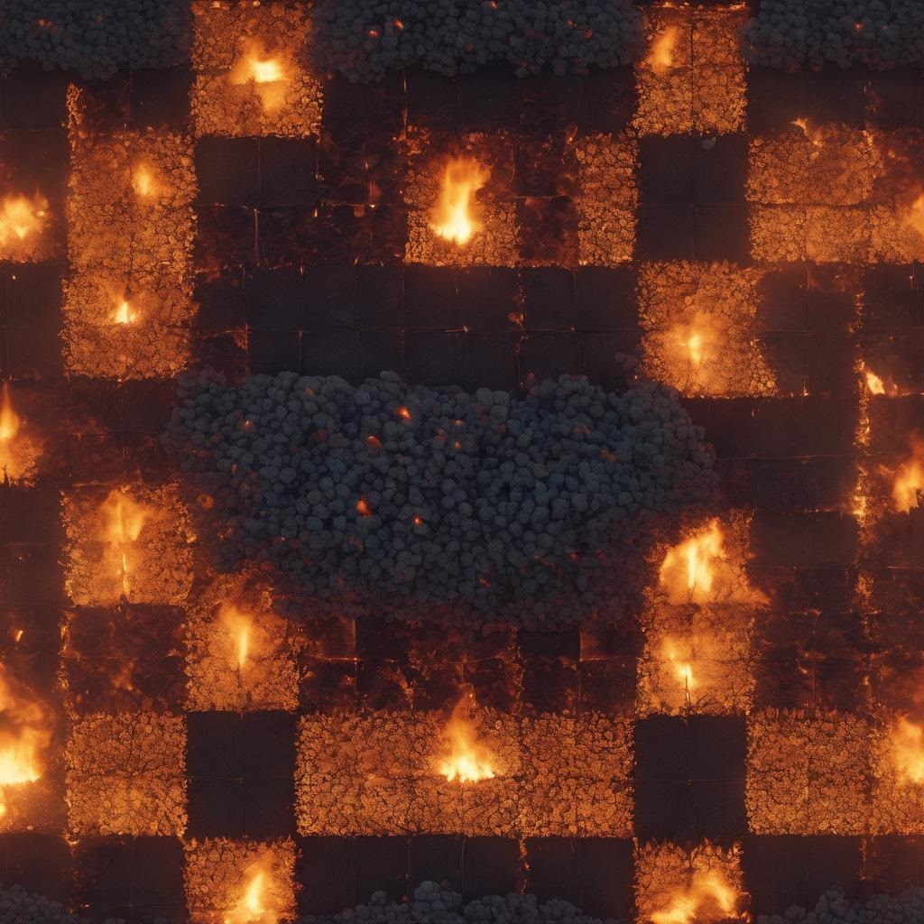
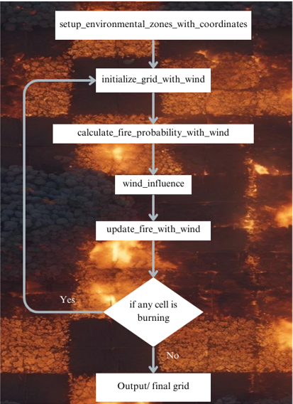
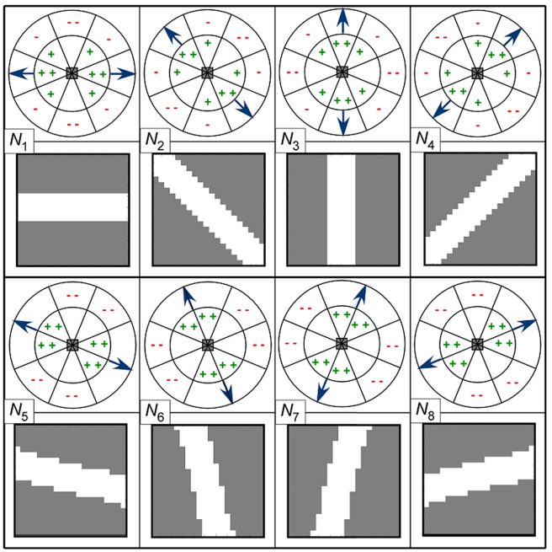
Proposed Approach
Cellular automaton representation
Introduction to cellular automaton-based model
Incorporation of zone-specific parameters and wind effects
Aim for a realistic representation of wildfire behavior
Notes:
our proposed cellular automaton-based wildfire spread simulation model stands at the forefront of addressing the limitations of existing approaches. By combining zone-specific parameters, wind effects, and stochastic elements, our model aims to provide a more realistic and adaptable tool for wildfire prediction, risk assessment, and management. The subsequent sections of this paper will delve into the intricacies of our model, present simulation results, and discuss its implications for wildfire research and real-world applications.

Slide 5
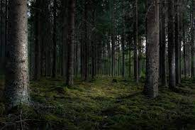
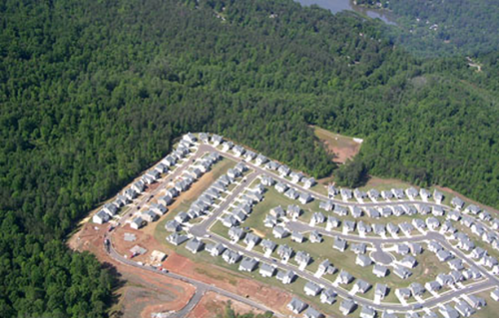






Three Main Environmental Zones
Forest, Urban, and Interface zones
Characteristics of each zone
Importance of zone-specific modeling
Notes:
Zone-specific Modeling: Scholars advocate for models that differentiate between environmental zones, acknowledging the varying fuel properties, vegetation density, and terrain characteristics. This approach allows for a more accurate representation of fire spread in diverse landscapes

Slide 6
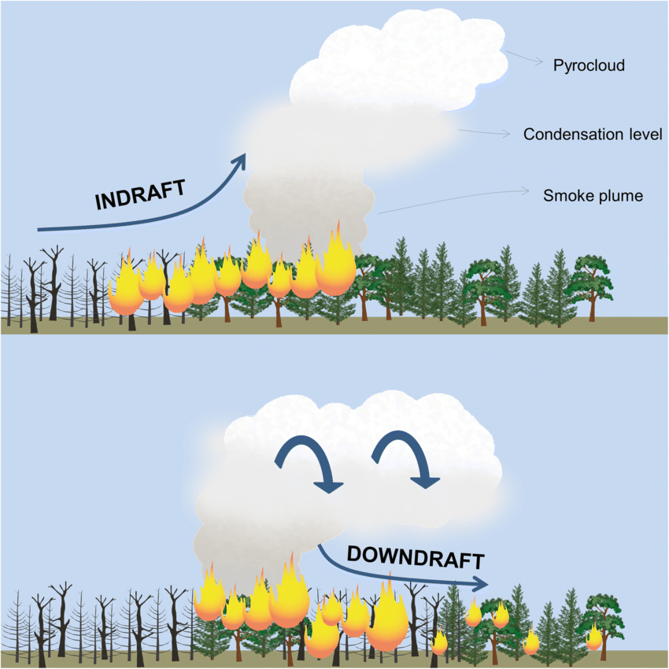
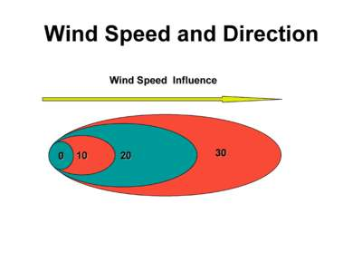
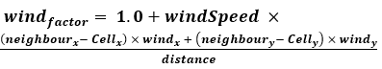
Wind Effects
Recognition of wind's critical role
Integration of wind speed and direction
Dynamic influence of wind on fire propagation
Notes:
Wind-influenced Modeling: Recognizing the critical role of wind in fire propagation, researchers propose models that incorporate wind effects. Considering wind speed and direction can significantly enhance the predictive capabilities of wildfire simulations

Slide 7
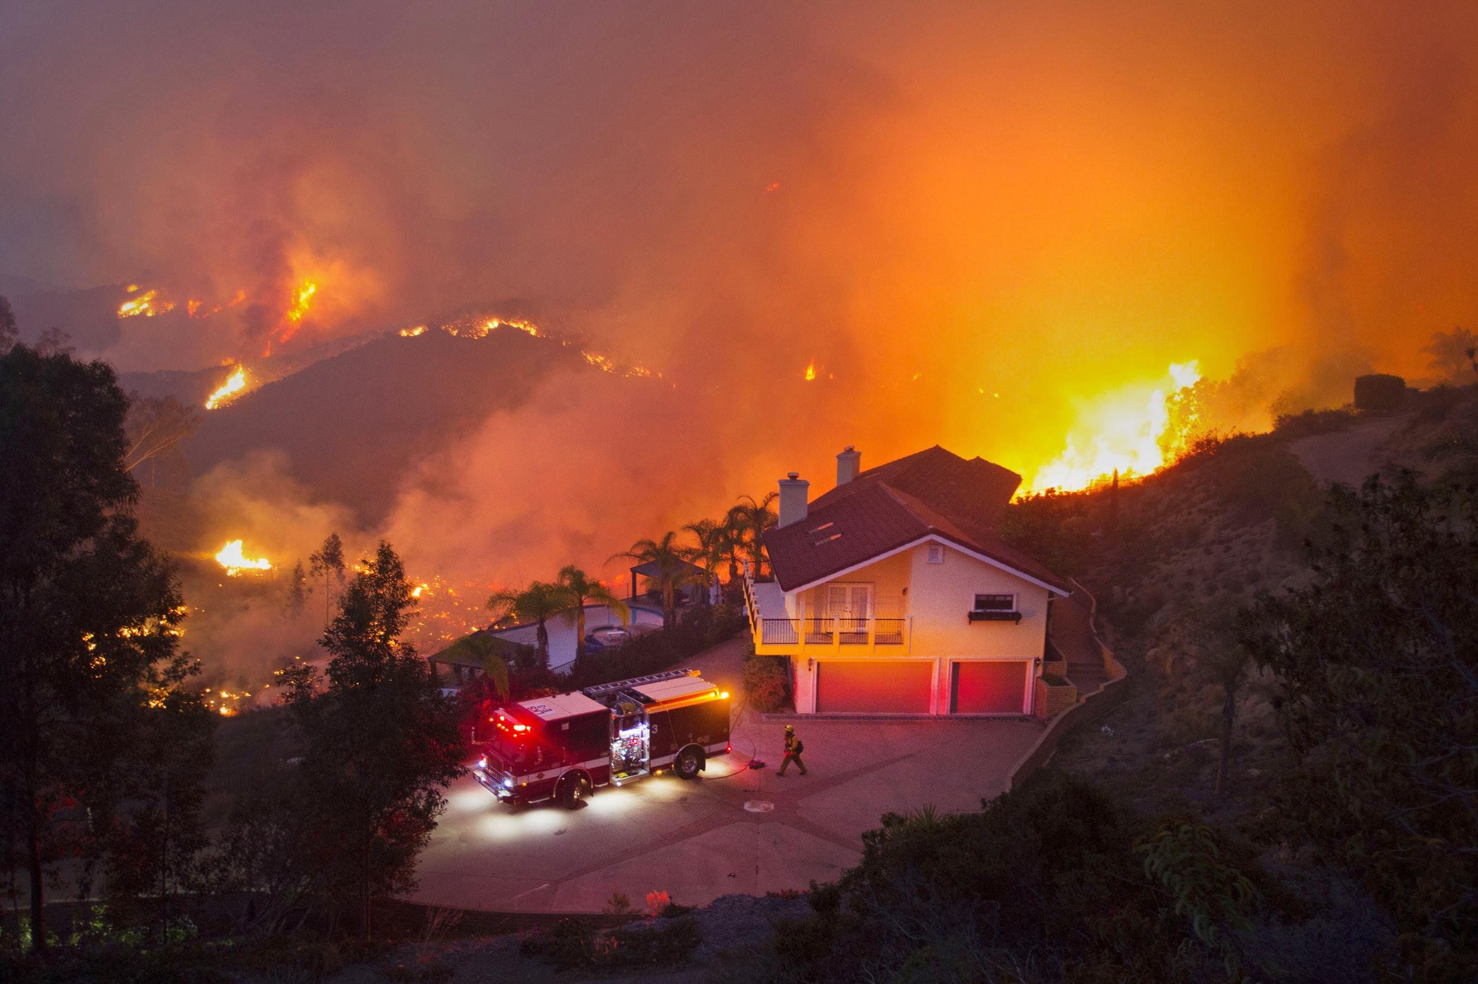
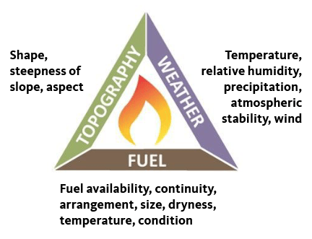
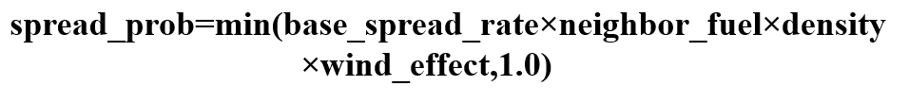
Stochastic Modeling
Introduction of randomness and uncertainty
Realistic portrayal of fire behavior
Significance in capturing unpredictability
Notes:
Stochastic Modeling: To better capture the unpredictability of real-world wildfires, there is a call for introducing stochastic elements into the models. This involves incorporating randomness and uncertainty, providing a more realistic portrayal of fire behavior

Slide 8

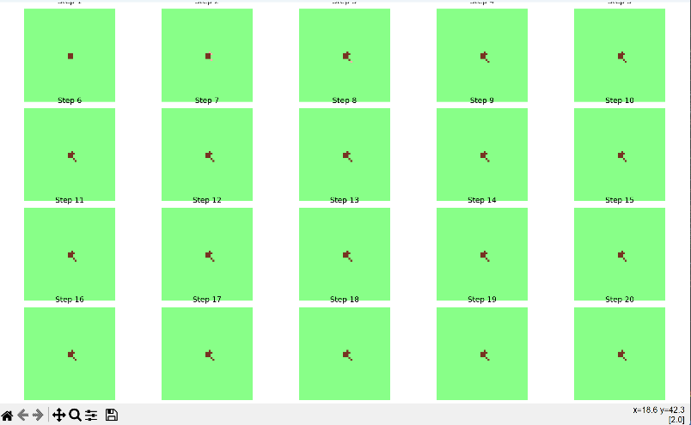
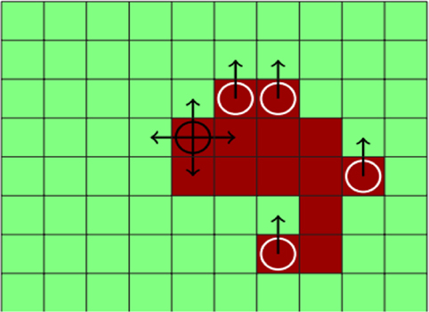
Simulation Results Overview
Zone-specific behavior
Impact of wind on fire spread
Stochastic variability
Notes:
The simulation presents us with a near accurate spread of wildfire. The below snippet is the screenshot of the simulation by the output.

Slide 9
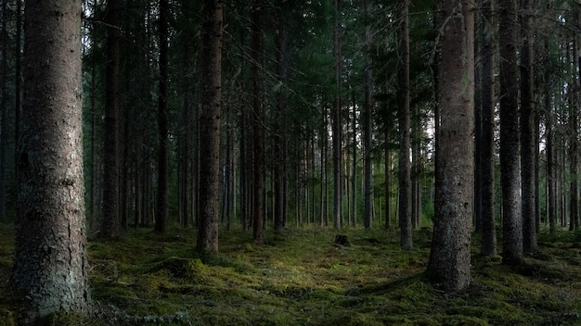
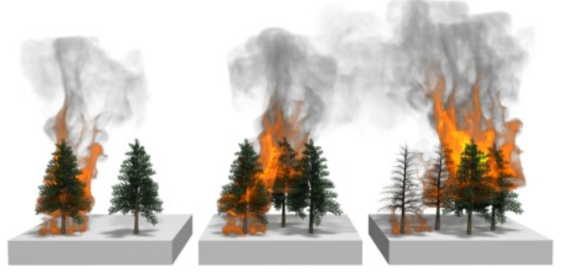
Forest Zone Dynamics
Higher vegetation density (0.5 to 0.8)
Rapid and expansive fire spread
Self-sustaining nature
Stochastic elements introducing variability
Notes:
In the forested zones, characterized by higher vegetation density, the model showcases rapid and expansive fire spread. This aligns with the expected behavior of wildfires in densely vegetated areas, where fuel availability plays a crucial role. The model successfully captures the self-sustaining nature of forest fires, demonstrating the potential for large-scale propagation.
Additionally, stochastic elements introduce variability in the outcomes, reflecting the inherent uncertainty in predicting the exact path and extent of a wildfire. This stochasticity adds a layer of realism, acknowledging that even with consistent conditions, the precise course of a wildfire remains unpredictable.

Slide 10

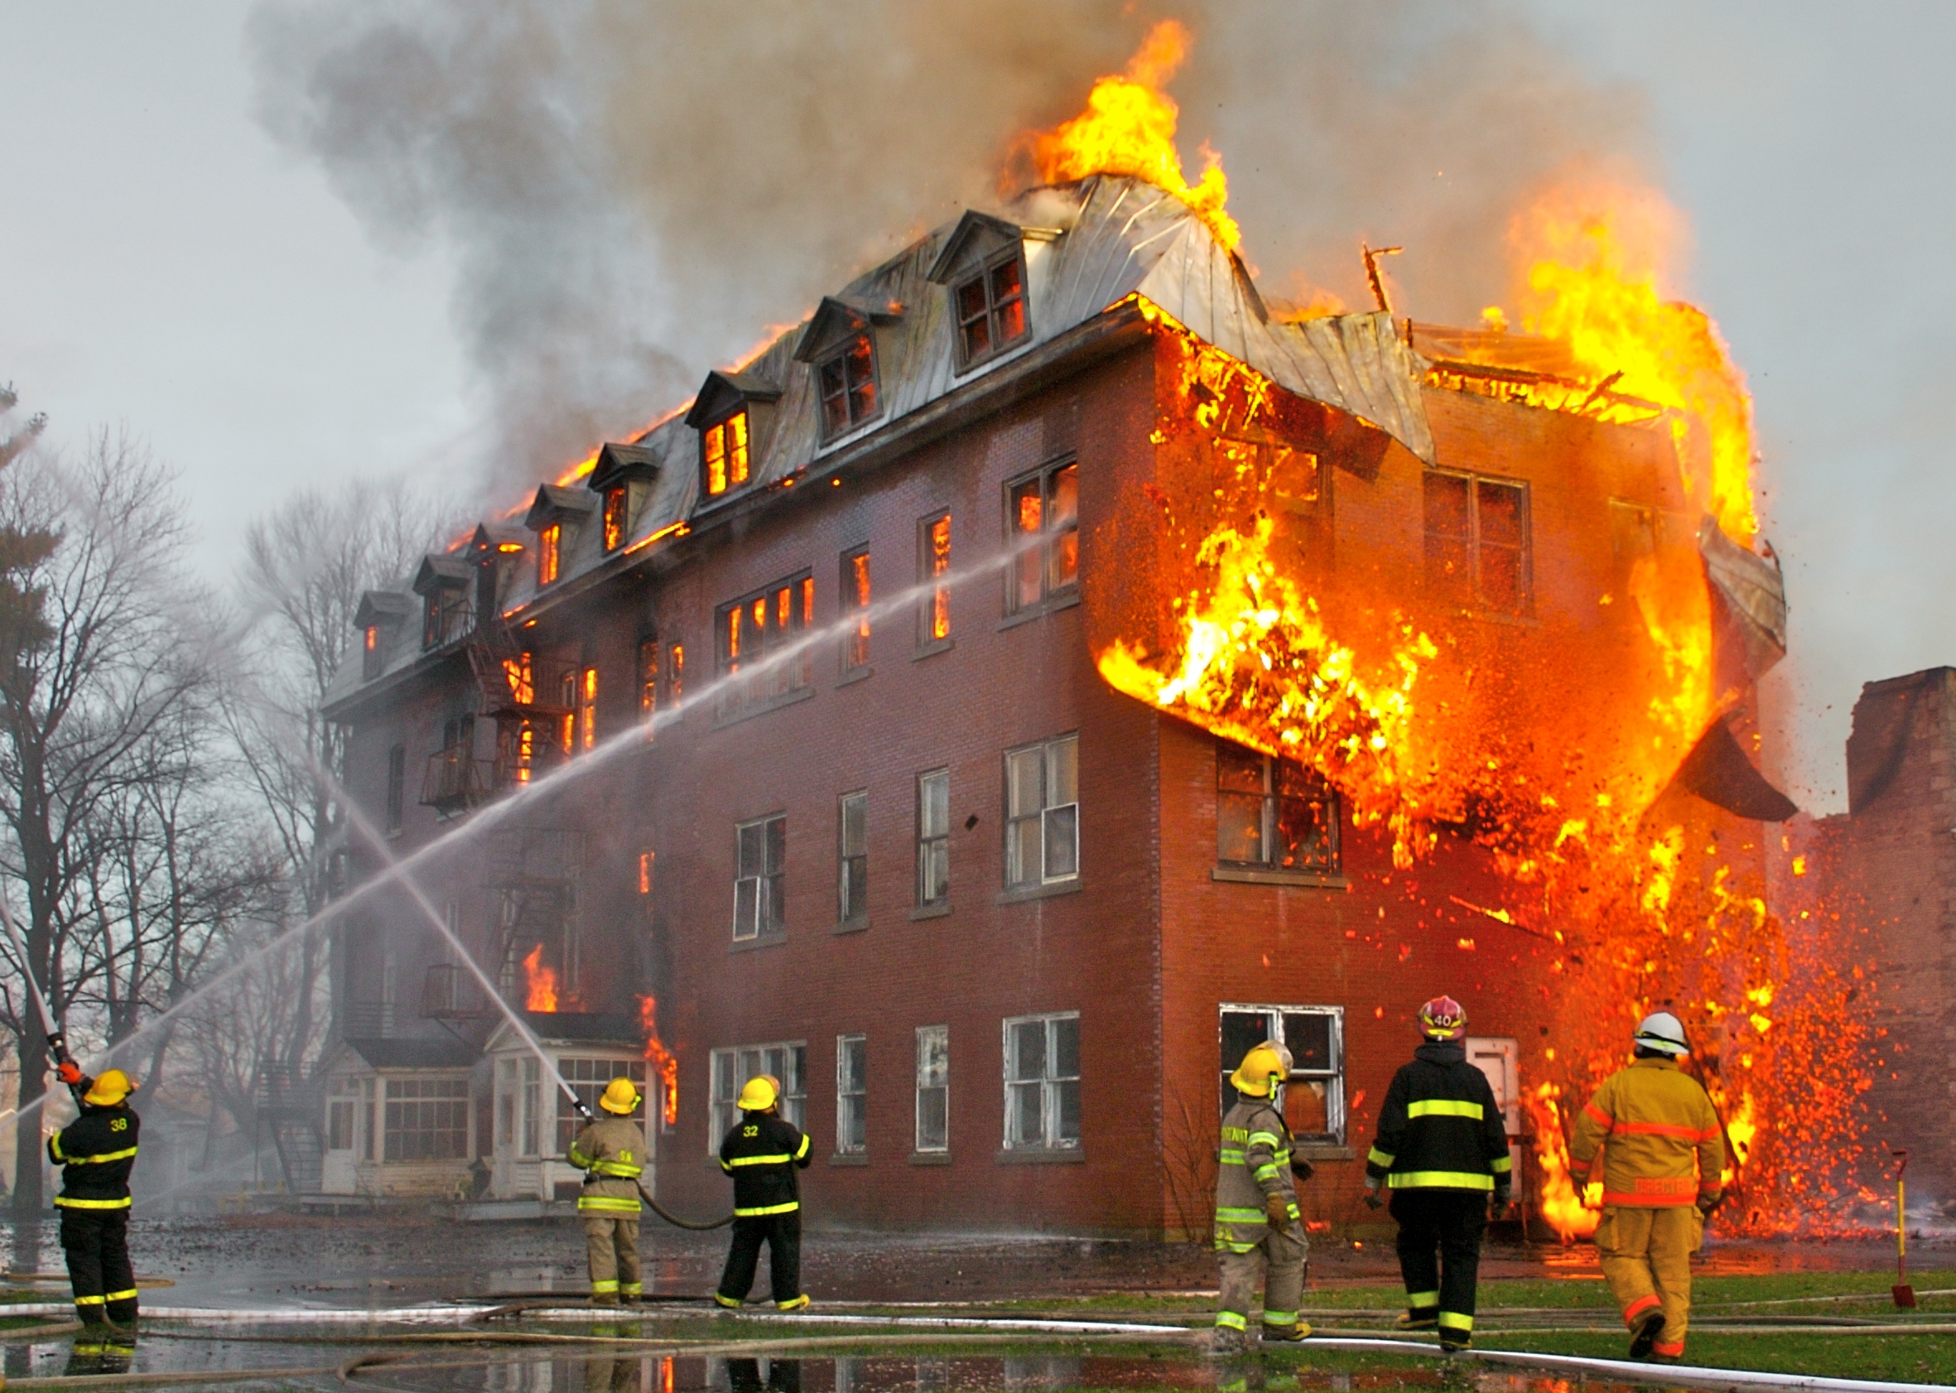
Urban Zone Containment
Controlled fire spread
Influence of lower vegetation density and buildings
Lower vegetation density (0.3 to 0.5)
Notes:
Contrasting with the forested areas, the urban zones exhibit more controlled fire spread. The lower vegetation density in urban environments, coupled with the presence of buildings acting as firebreaks, contributes to a slower and more contained spread. This behavior is consistent with real-world scenarios where urban planning and infrastructure can influence the course of wildfires.
The model's representation of urban zones highlights the potential effectiveness of strategic urban planning in mitigating wildfire impact. This insight is valuable for urban planners and policymakers seeking to implement measures to safeguard communities from wildfires.

Slide 11
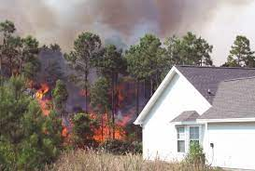
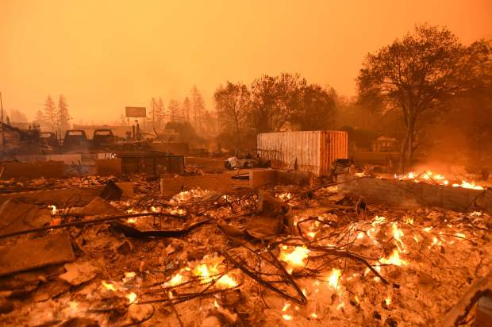
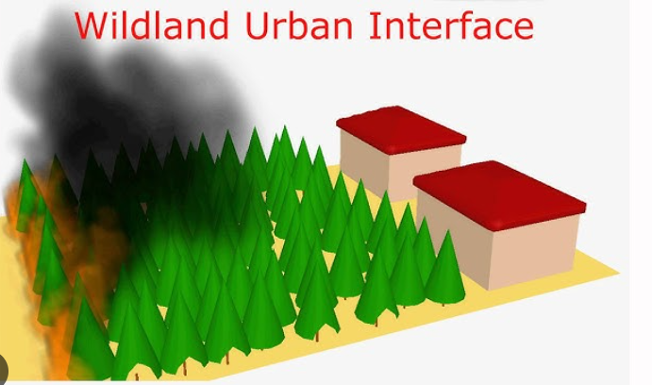
Interface Zone Transition
Balance between rapid and controlled spread
Influence of varying vegetation and buildings
Moderate vegetation density (0.4 to 0.7)
Notes:
Interface Zone Transition:
The interface zones, representing transitional areas between forest and urban environments, demonstrate a balance between rapid and controlled fire spread. This behavior captures the complexity of regions where vegetation density varies, and the presence of buildings influences the fire's progression.
The model's ability to simulate interface zones provides crucial insights for assessing the risk in regions characterized by a mix of natural and urban elements. Identifying such transitional areas is vital for proactive wildfire management and strategic resource allocation.

Slide 12
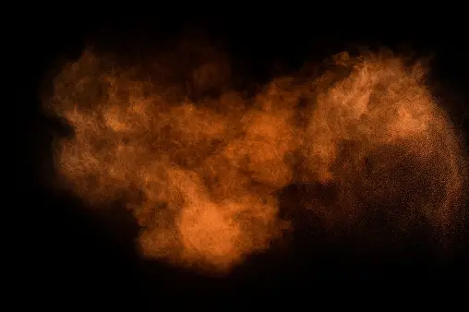
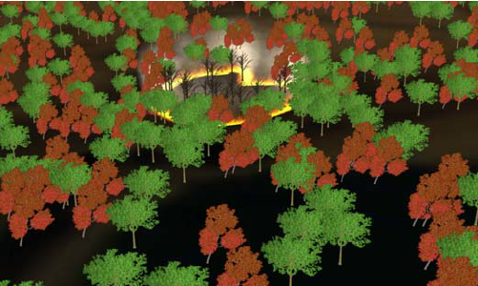
Advantages and Disadvantages
Realism, versatility, and educational value
Computational intensity and simplified terrain
Notes:
a. Advantages:
Realism: The model's incorporation of zone-specific parameters, wind effects, and stochastic elements contributes to a more realistic representation of wildfire dynamics, enhancing its applicability to diverse landscapes. The simulation results exhibit a close alignment with observed real-world wildfire behaviors, validating the model's ability to capture the intricacies of different environmental zones.
Versatility: The model's versatility allows it to be applied across different scenarios and environments. Through controlled experimentation, the simulation successfully replicated a range of conditions, showcasing its adaptability. This versatility is essential for addressing the complexities of varied landscapes and predicting wildfire behavior under changing weather patterns and environmental factors.
Educational Tool: The clear visualization of simulation results makes the model an effective educational tool. The visually striking output aids in conveying the intricate dynamics of wildfires to a broad audience, including researchers, students, and the general public. The intuitive representation facilitates a deeper understanding of how factors such as wind, terrain, and vegetation influence the spread of wildfires.
b. Disadvantages:
Computational Intensity: The model's reliance on cellular automata and multiple iterations for each time step can lead to computational intensity, particularly for large grid sizes. As the simulation grid expands, the computational load increases proportionally. Addressing this challenge may involve optimizing the algorithm or exploring parallel computing solutions to enhance efficiency, especially for real-time applications.

Slide 13

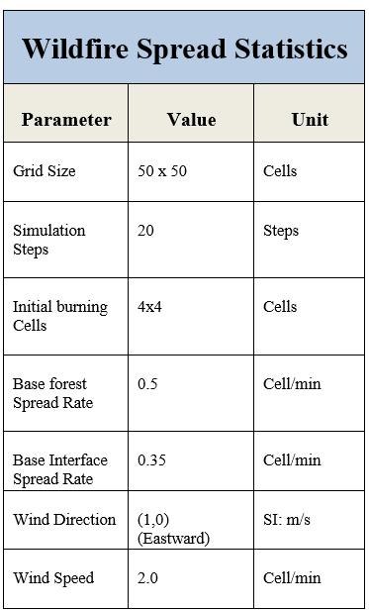
Wildfire Spread Statistics Table
Notes:
After simulating the program for several times, we have recorded one of the instance in the tabular form, calling it “Wildfire Spread Statistics Table.” The presented table encapsulates crucial statistics derived from the wildfire spread simulation model, providing a concise overview of key parameters and characteristics. As a fundamental component of the research, these statistics play a pivotal role in understanding, analyzing, and interpreting the behavior of wildfires in diverse environments.
This table summarizes key parameters and characteristics of the wildfire spread simulation, providing an overview of the model's setup. Adjustments to grid size, simulation steps, initial burning cells, and base spread rates can influence the model's behavior and are crucial for tailoring simulations to specific scenarios.

Slide 14
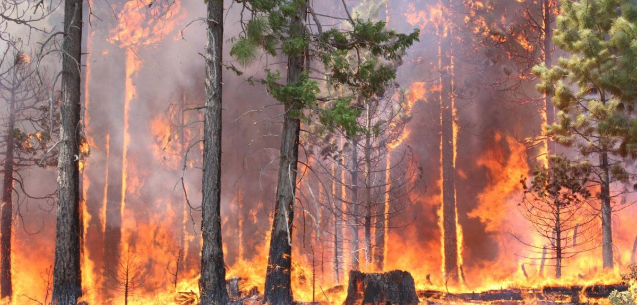
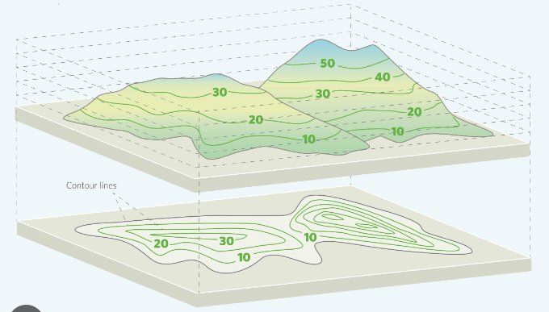
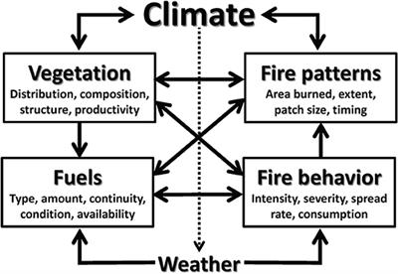
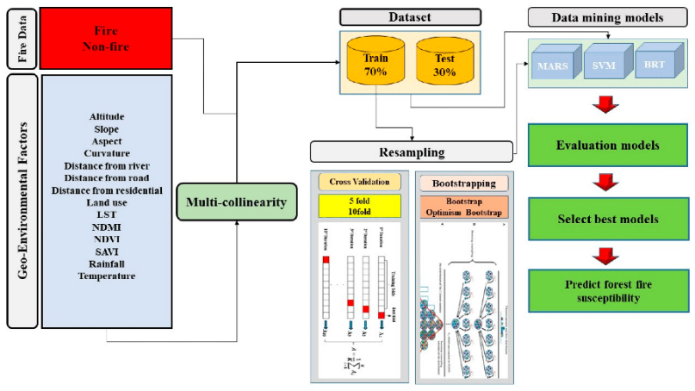
Future Scope and Extension
Integration of topographical features
Dynamic fuel load modeling
Machine learning calibration and urban planning impact
Notes:
1. Integration of Topographical Features:
The model's realism could be further elevated by incorporating detailed topographical features, such as elevation changes and varying vegetation types[20]. This extension would enable a more accurate representation of diverse landscapes, improving the model's applicability in regions with complex terrains.
2. Dynamic Fuel Load Modeling:
A dynamic fuel load model could introduce temporal changes in vegetation density, reflecting seasonal variations and long-term
environmental shifts. This addition would contribute to a more nuanced understanding of how evolving fuel conditions impact wildfire spread over time.
3. Machine Learning Calibration:
Implementing machine learning techniques for model calibration could enhance the accuracy of zone-specific parameters. By leveraging historical wildfire data, the model could adapt and optimize its parameters based on real-world observations, improving predictive capabilities.

Slide 15

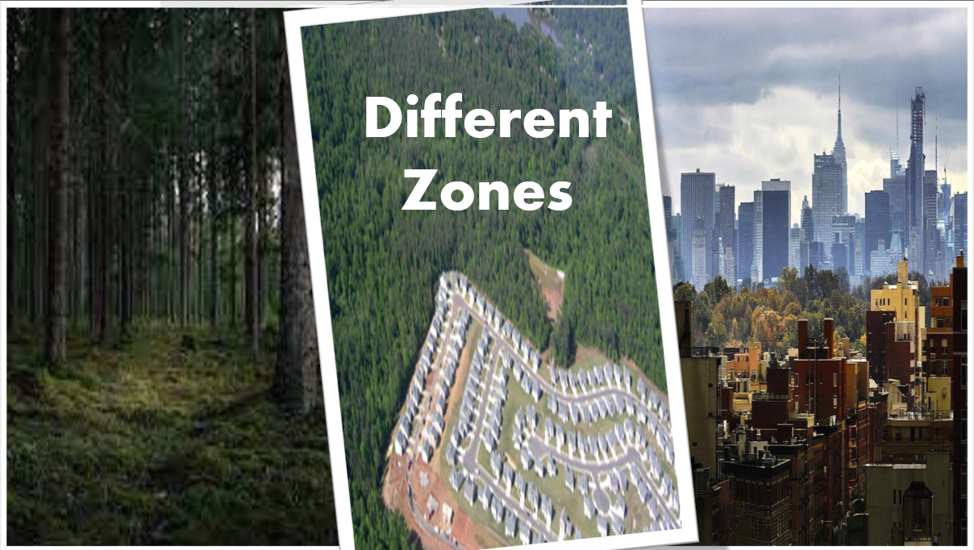

Conclusion
Model Validation:
Realistic Representation:
Educational Tool:
Versatility:
Practical Utility:
Cellular automaton representation
Visualization of realistic wildfire dynamics
Notes:
Model Validation:
The cellular automaton-based model successfully validated against observed real-world wildfire behaviors.
Realistic Representation:
Incorporation of zone-specific parameters, wind effects, and stochastic elements resulted in a realistic portrayal of wildfire dynamics.
Educational Tool:
Clear visual output makes it an effective educational tool for conveying wildfire dynamics.
Versatility:
The model's versatility allows application across diverse scenarios, predicting wildfire behavior under changing conditions.
Practical Utility:
Holds practical utility for wildfire prediction, risk assessment, and management.
Real-world Use:
Beyond theoretical application, the model provides tangible benefits for real-world decision-making in wildfire-prone regions.

